Slide 1
Introducing Learning Algorithms within an Operational State Aggregation Method for Transmission System Planning
Kristof Phillips and Erik F. Alvarez

Slide 2
Problem setting

Slide 3
Benchmark:
Full time horizon
Input Data
ESOM
Input Time Series
Clustering
Method
Representative Time Series
ESOM
Traditional:
Split time horizon
Features
Clustering
Method
Representative Time Series
ESOM
Based in Costs:
Split time horizon
Relaxed ESOM
(ANN + Kmedoids)
Clustering
Method
Investment Benefit
Proposal:
Split time horizon
ANN: Cost Estimator
Features
(Investment benefit)
Representative Time Series
ESOM

Slide 4
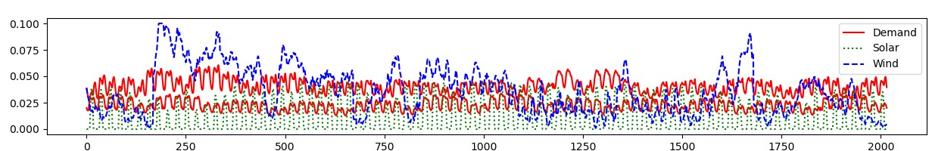
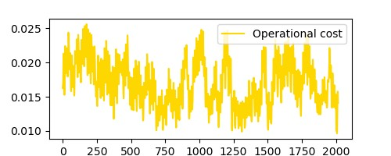
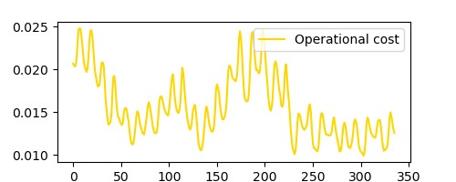
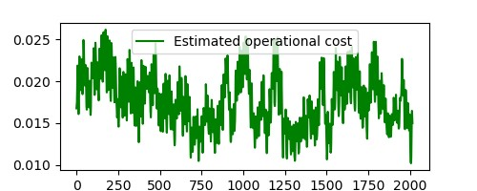
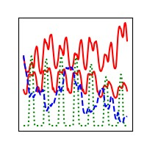
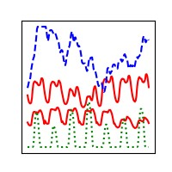
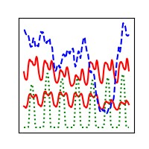
Relaxed ESOM
Relaxed ESOM
Features
Clustering
Method
Clustering
Method
Training
Evaluation
Clustering
Method
Representative Time Series
ML algorithm
NN-assisted Ex-post clustering
No temporal reduction
Input-based clustering
Ex-post clustering
ESOM
ESOM
ESOM
ESOM

Slide 5
Neural Network for cost estimation
Goal
Estimate the hourly operational cost of the OPF problem
Sensitive to
time-series changes
physical network changes
Approach
Neural network works on hourly basis → Estimates one cost value
Single output (cost)
Input contains
Demand (per node)
Renewable availability factors (per technology per location)
Investment Booleans representing physical network characteristics
Demands
Availabilities
Investment booleans
Input layer
…
…
…
Hidden layer
…
Single output
Operational cost for one hour

Slide 6
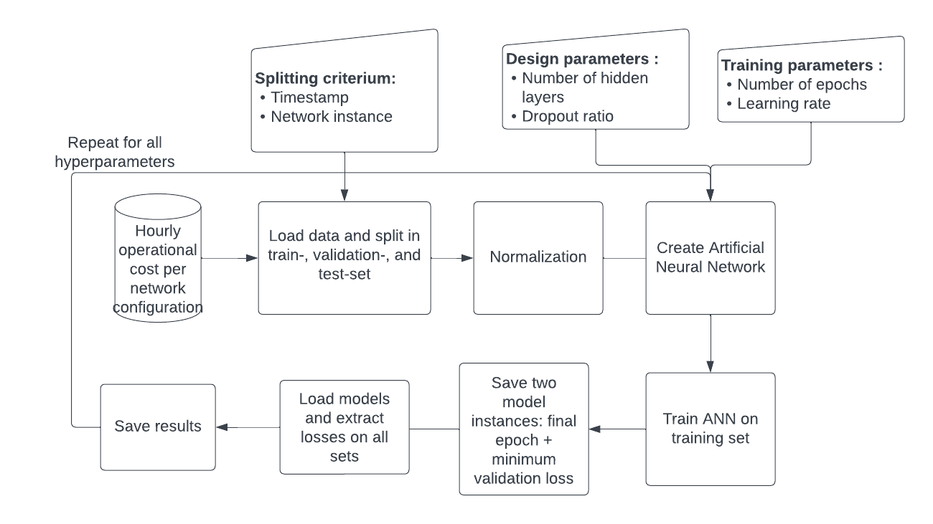
Neural network training
Goal
Train and test on a subset of desired outcomes
Achieve speedup by obtaining remaining outcomes with NN instead of optimization
Approach
Optimization performed for
Set of 84 random days
All individual line candidates
Split obtained dataset into training and test sets
Tune network design to obtain best result on test set

Slide 7
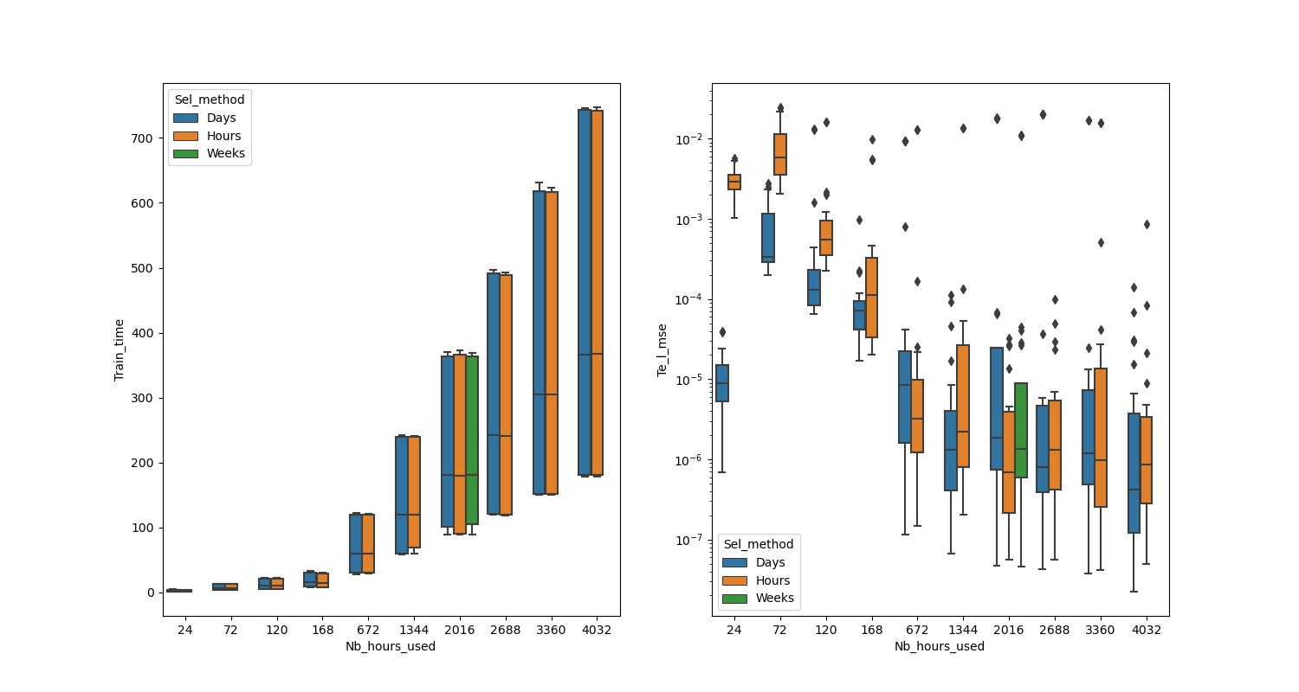
Neural network training
Goal
Train and test on a subset of desired outcomes
Achieve speedup by obtaining remaining outcomes with NN instead of optimization
Approach
Optimization performed for
Set of 84 random days
All individual line candidates
Split obtained dataset into training and test sets
Tune network design to obtain best result on test set

Slide 8
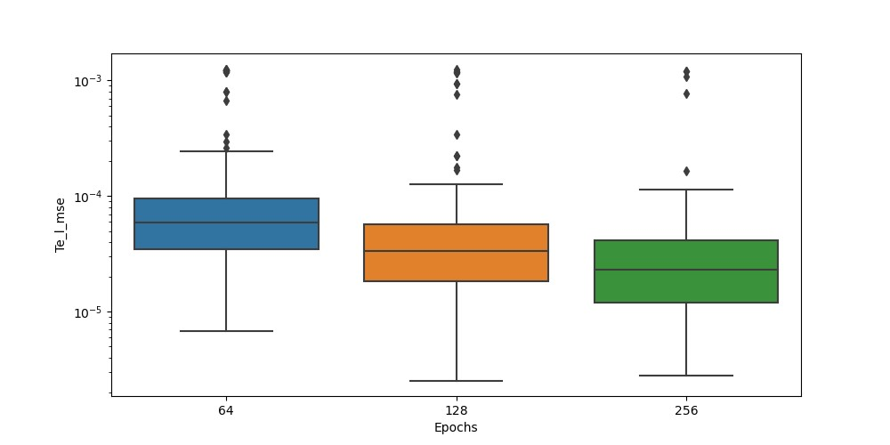
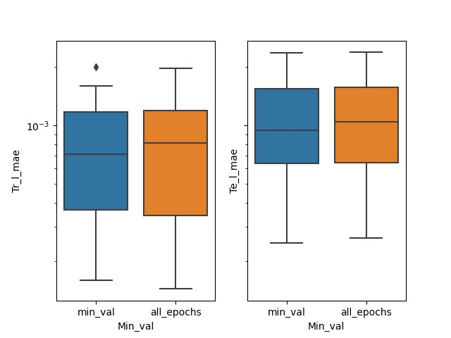
Neural network training
Goal
Train and test on a subset of desired outcomes
Achieve speedup by obtaining remaining outcomes with NN instead of optimization
Approach
Optimization performed for
Set of 84 random days
All individual line candidates
Split obtained dataset into training and test sets
Tune network design to obtain best result on test set

Slide 9
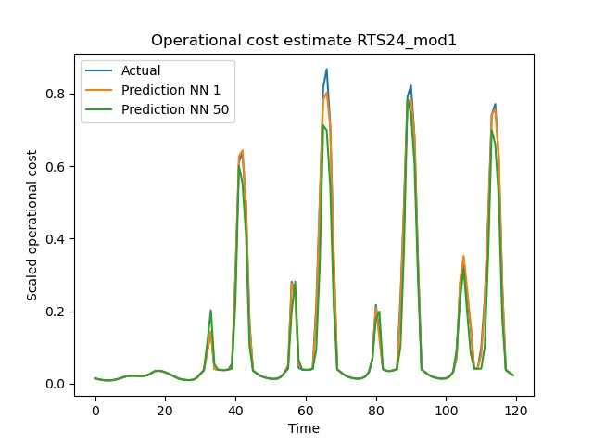
Operational cost estimation

Slide 10
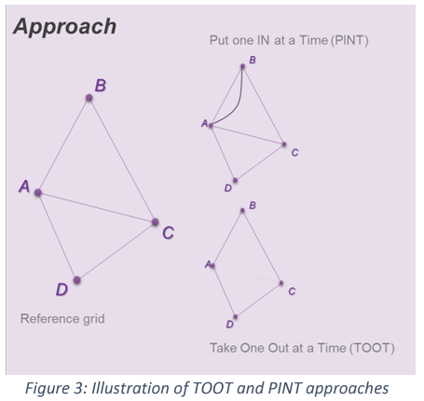
Line benefits
The PINT and TOOT
Investment Benefit
ANN: Cost Estimator
Sequence per candidate asset and hour
PINT (or TOOT)
Reference grid
ANN Cost
Estimator
ANN Cost
Estimator
Line Benefit Methods:
The Put IN one at the Time (PINT)
The Take Out One at the Time (TOOT)
Shapley value
Aumann-shapley value
Benefit 1 (Benefit 2) =
Reference grid – PINT
(TOOT – Reference grid)
[source] ENTSO-E: Guideline for Cost Benefit Analysis of Grid Development Projects
Link: https://eepublicdownloads.entsoe.eu/clean-documents/tyndp-documents/Cost%20Benefit%20Analysis/191023_CBA3_Draft%20for%20consultation.pdf
Disadvantages of the PINT:
Computationally expensive
>~15 hours for all the process in the RTS24

Slide 11
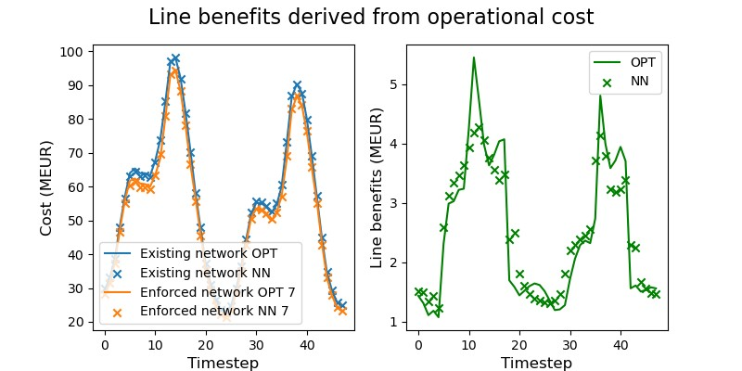
Line benefits estimation

Slide 12
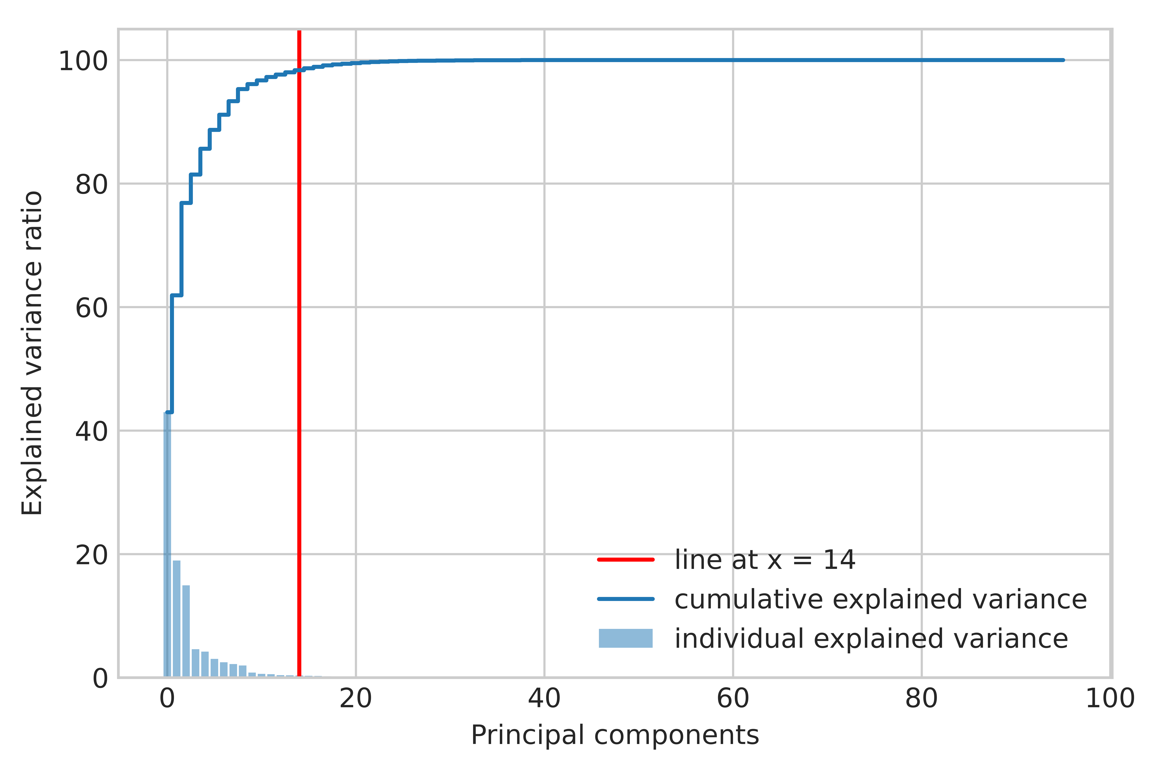
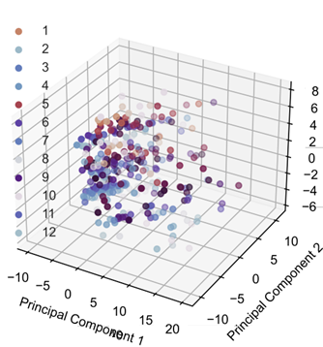
Clustering process
Dimensionality reduction
Optimal number of representatives/clusters
Selection/aggregation using K-medoids
Dimensionality reduction using PCA
Optimal number of clusters:
Elbow method

Slide 13
Representative hours

Slide 14
Benchmarking

Slide 15
Benchmarking

